Slide 1



PROJECT MANAGEMENT IN PRACTICE
Project Scope Management
Lecture No: 5 Week: 3
Vispi Shroff
Sub Heading
And Date

Slide 2

Recap
Project Integration Management
Project Selection
Strategic Planning
Project Selection Methods
Developing the Project Charter
Developing the Project Management Plan
Project Execution
Process of monitoring and Controlling Project Work
Change Control & Change Management
Closing a Project

Slide 3
Today’s Topics & Learning Outcomes
Importance of good project scope management
Methods of collection and documentation of requirements
Scope definition process
Contents of a project scope statement
Creating a work breakdown structure (WBS)
Different methods for creation
Importance of verifying scope
Controlling scope; avoiding scope creep

Slide 4
What is Scope Management
Looks at the processes involved in the definition and control of what is and what is not in a project.
Scope refers to ALL the work involved in creating the products of a project and the processes used to create them.
A Deliverable is a product produced as part of a project, such as hardware or software, planning documents, etc.
What about services...?

Slide 5
Project Scope Management Processes
Collecting Requirements
Collecting requirements: defining and documenting the features and functions of the products produced during the project as well as the processes used for creating them
Defining scope: reviewing the project charter, requirements documents, and organizational process assets to create a scope statement
Creating the WBS: subdividing the major project deliverables into smaller, more manageable components
Verifying scope: formalizing acceptance of the project deliverables
Controlling scope: controlling changes to project scope throughout the life of the project
Defining Scope
Create the WBS
Controlling the Scope
Verify the scope

Slide 6
Collecting Requirements
A requirement is “a condition or capability that must be met or possessed by a system, product, service, result, or component to satisfy a contract, standard, specification, or other formal document”
“A software requirement is a property which must be exhibited by software developed or adapted to solve a particular problem.” - SWEBOK
It is important to use an iterative approach to defining requirements since they are often unclear early in a project

Slide 7
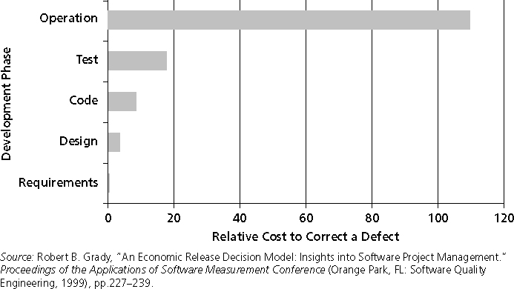
Cost to correct a Software Requirement Defect
So..
Verify
&
Validate.

Slide 8
Methods for collecting requirements
- Interviewing
- Focus groups and facilitated workshops
- Using group creativity and decision-making techniques
- Questionnaires and surveys
- Observation
- Prototyping
- Software tools
Best Practices for Requirements
Have a Requirements Management Plan
Have a Requirements Traceability Matrix
Look up SWEBOK, Chapter 2

Slide 9
Defining Scope
Key Inputs?
Project Charter
Requirements documentation
Organisational Policies and procedures
Lessons learned from previous/similar projects
Over time, Scope should become
More Clear
More Specific

Slide 10
Defining a WBS
- A WBS is a deliverable-oriented grouping of the work involved in a project that defines the total scope of the project
- WBS is a foundation document that provides the basis for planning and managing project schedules, costs, resources, and changes
- Decomposition is subdividing project deliverables into smaller pieces
- A work package is a task at the lowest level of the WBS

Slide 11
Approaches to Developing WBS
- Using guidelines: some organizations, like the DOD, provide guidelines for preparing WBSs
- The analogy approach: review WBSs of similar projects and tailor to your project
- The top-down approach: start with the largest items of the project and break them down
- The bottom-up approach: start with the specific tasks and roll them up
- Mind-mapping approach: mind mapping is a technique that uses branches radiating out from a core idea to structure thoughts and ideas

Slide 12
Creating a WBS
- Activity

Slide 13
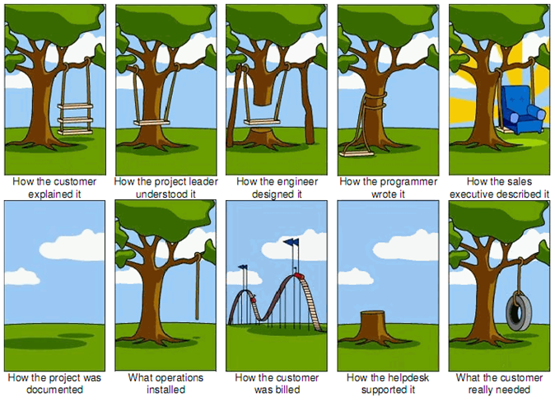
Verifying Scope

Slide 14
Verifying Scope
- It is very difficult to create a good scope statement and WBS for a project
- It is even more difficult to verify project scope and minimize scope changes
- Scope verification involves formal acceptance of the completed project scope by the stakeholders
- Acceptance is often achieved by a customer inspection and then sign-off on key deliverables

Slide 15
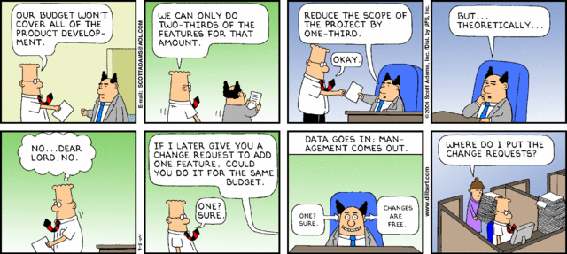
Scope Control… in Reality?
- 5 September 2004

Slide 16
Controlling Scope
- Scope control involves controlling changes to the project scope
- Goals of scope control are to:
Influence the factors that cause scope changes
Assure changes are processed according to procedures developed as part of integrated change control
Manage changes when they occur
- Variance is the difference between planned and actual performance

Slide 17
Best Practices for avoiding Scope Problems
Keep it realistic
Involve stakeholders and users
Follow good PM & Software Processes, use the Body of Knowledge documents
Use hardware and software tools to assist you

Slide 18
How to improve User Input
... and thus, Requirements & Scope
Develop a good project selection process
Regular meetings with defined agendas; sign offs on action points
Deliver something to users and sponsors on a regular
Deliver on a regular basis
Don’t promise something you can’t deliver
Co-locate users with developers (or vice versa)

Slide 19
Suggestions for Reducing Incomplete and Changing Requirements
Requirements Management – Develop and follow the processes
Get more user feedback through... Prototyping, use case modelling
Put requirements in writing
Requirements Database for documenting and controlling requirements
Review changes
Emphasize priorities and completion dates
Allocate resources specifically for handling change requests/enhancements.

Slide 20
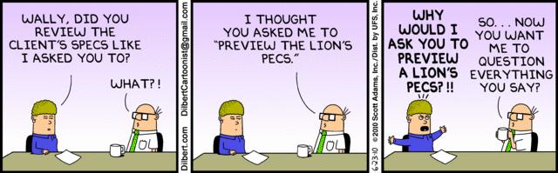
Any Thoughts, Questions, Ideas?
- June 23, 2010

Slide 21
Reading Materials for the Week
PMBOK – Chapters 5 & 6
Schwalbe, K - Information Technology Project Management – Chapters 5 & 6

Slide 22
Conclusions
We looked at
The Importance of Scope Management
Methods of collection and documentation of requirements
Scope definition process
Contents of a project scope statement
Creating a work breakdown structure (WBS)
Different methods for creation
Importance of verifying scope
Controlling scope; avoiding scope creep

Slide 23
References
- PMBOK – Chapters 5
- Schwalbe, K - Information Technology Project Management – Chapters 5
- Dilbert Comics

